Slide 1

Technical Skills
Intro to Git - Working with Git and Repositories

Slide 2
The Deadline is approaching...

Slide 3
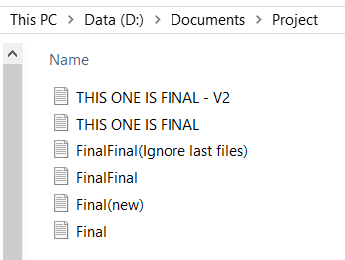
1l0v3br14n

Slide 4
For Group Projects, this is even worse.
Group projects will suffer from;
Members performing redundant tasks
Multiple, differing copies of the same project
Slower development timelines

Slide 5
How could we represent this?
Final
Final(new)
FinalFinal
THIS ONE IS FINAL
THIS ONE IS FINAL - V2
FinalFinal(ignore last files)

Slide 6
A better way of managing the project?

Slide 7
Solution - Version Control System
A VCS tracks the history of changes contributors have made to a project.
Any version can be recovered at any time. You can tell;
Which changes were made?
Who made the changes?
When the changes were made?
Why the changes were needed?

Slide 8

Say Hello to Git
Git is a Distributed Version Control System that 70% of developers use.
It is lightweight and straightforward to learn.
It uses terminal commands to maintain the project.

Slide 9
Git Download Link
https://git-scm.com/downloads

Slide 10
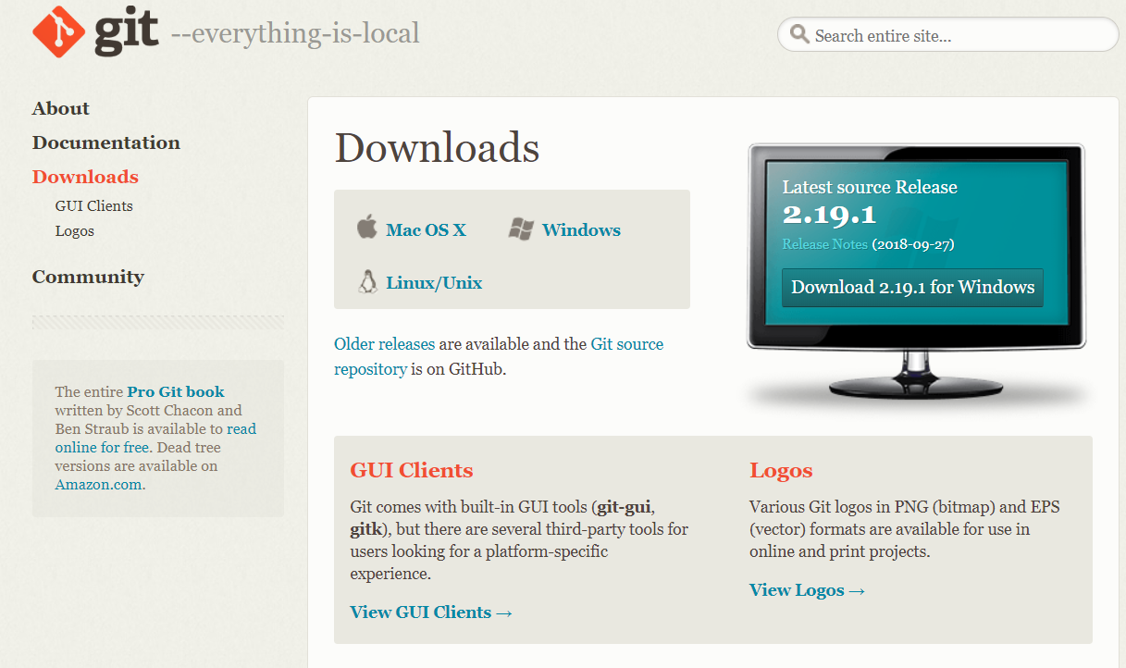
Installing Git

Slide 11
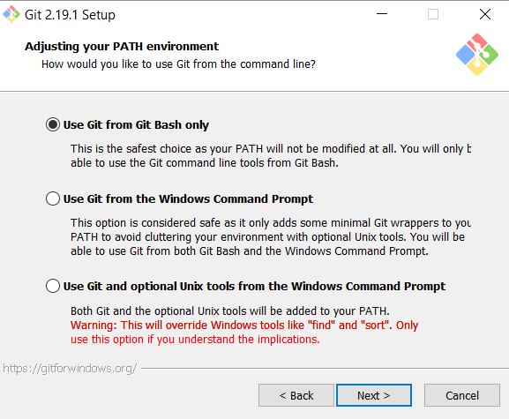
Installing Git
Use Git Bash Only

Slide 12
We have our DVCS installed, now onto the Repository itself

Slide 13
What is a Repository?
A Repository is basically a Project Folder. For this, we will be using GitHub.
It contains all of the folders and files within a project, along with each file’s revision history.
File history appears as snapshots in time called Commits (we’ll see these soon), a copy of the version of the project at that time.
These commits can be organised into lines of development, known as Branches. We’ve seen previously how these branches of development can be represented;
Each node is a commit to the Repository

Slide 14
Repository Branches
The default branch to a project will be the Master branch. This is where the main project will exist.
In branches, an important concept is the HEAD, a pointer that points to a commit within a branch. Every time you commit to the repository, this pointer will automatically move to the newest commit.
Master
Master

Slide 15
Repository Branches
Within Git, you are able to make new branches. This is an incredibly useful feature, as it allows you to diverge from the main line of development and continue to do work without messing with the main line.
You are able to make a new HEAD pointer which will point to a new branch which can then be independently developed in.
This allows for multiple simultaneous features to be developed without affecting each other.
MyBranch
Master

Slide 16
Repository Branches
Master
Master
myBranch
Master
Master
myBranch
myBranch

Slide 17
Setting up GitHub as a Repository
https://github.com

Slide 18
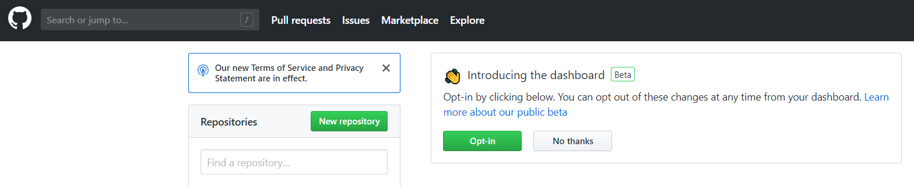
Setting up GitHub as a Repository

Slide 19
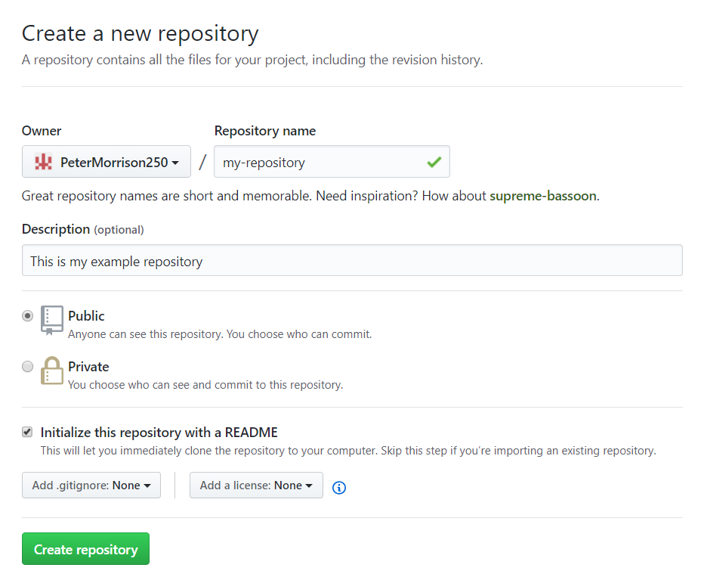
Setting up GitHub as a Repository

Slide 20
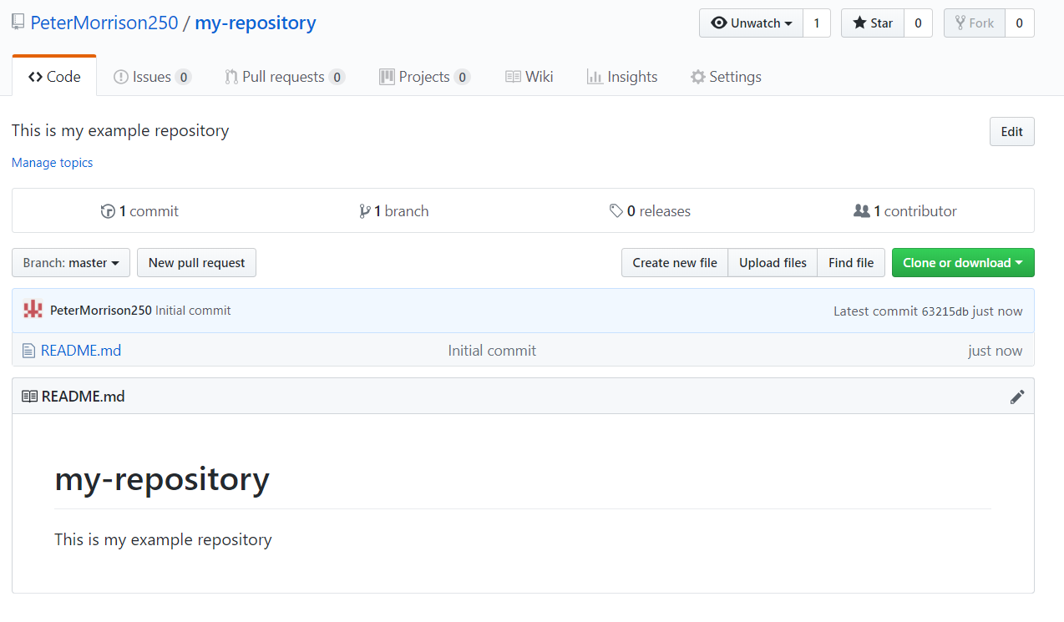
Setting up GitHub as a Repository

Slide 21
Time to connect our Remote Repository to our computer

Slide 22
Useful Terminal Commands
$ cd | Change directory e.g. $ cd c/documents/ moves terminal into documents folder. $ cd .. moves terminal back one folder level
$ ls | Lists all files within current folder
$ clear | Clears terminal of text

Slide 23
Setting up Git Configurations
Global denotes that file should be created globally, not per project
Config creates the .config file to store git settings.
Config attribute you want changed
Git has a .config file that stores information about the user. This is used to connect to GitHub.
The config file can be found at c/users/<username>/.gitconfig
$ git config --global user.name “”
git will always be present at the beginning of a Git command
-- denotes extra options for the command.
Within the quotes, insert your GitHub username

Slide 24
Setting up Git Configurations
Global denotes that file should be created globally, not per project
Config creates the .config file to store git settings.
Config attribute you want changed
Git has a .config file that stores information about the user. This is used to connect to GitHub.
The config file can be found at c/users/<username>/.gitconfig
$ git config --global user.email “”
git will always be present at the beginning of a Git command
-- denotes extra options for the command.
Within the quotes, insert your GitHub email address

Slide 25
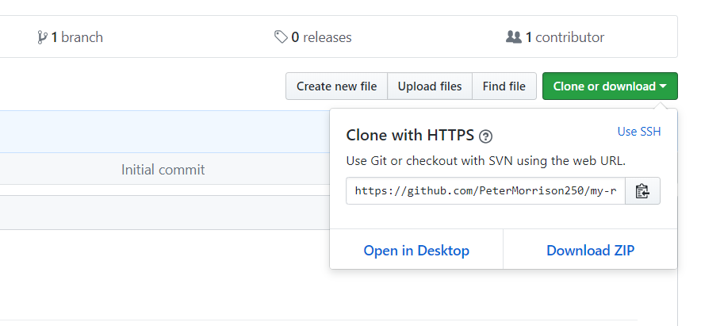
Copy the HTTPS URL

Slide 26
Copying a Pre-Existing Repository
Using the git clone command, we make a copy of the remote repository from GitHub to our local machine.
$ git clone <HTTPS>
Paste HTTPS URL link from GitHub page

Slide 27
Branches within Git
Using the git branch command, we can see a list of all current branches existing within this repository.
The branch we currently reside in will be denoted by a * and highlighted green.
Current branch is also denoted in Git by the blue brackets after the directory path.
$ git branch
Command lists all branches

Slide 28
Branches within Git
-b is a shortcut command for git branch.
Using git checkout -b, we can create a new branch, and then move to it.
We need to specify the name of the new branch that we are creating in the branchName section of the command.
The command combines the functionality of the git branch command, as it both creates and moves to the new branch.
$ git checkout -b <branchName>
Define the branch you want to move to here

Slide 29
Branches within Git
Using git checkout, we can move between branches that we have created.
We need to specify the name of the branch we want to move to.
This command is useful in conjunction with the git branch command; to see what branches there are, then to move to one.
$ git checkout <branchName>
Define the branch you want to move to here

Slide 30
Time to create some new files

Slide 31
Repository Branches
Master
Origin/master

Slide 32
Adding Files to GitHub
Remote Repository
- GitHub
Local Repository - Computer
Local Files within file explorer
(Working Directory)
Local File Staging Area

Slide 33
Status of files
Git status will return a status report on the state of the current project.
It will list off any files that have been modified/created, and if they have been added to the staging area.
Files that have been added are highlighted in green. Files that have not, are in red.
$ git status
Returns a status report of the current project.

Slide 34
Adding Files to Staging Area
To get files copied to the remote repository, we need to first add them to the staging area, before being packaged and sent off.
Git add adds the files to the staging area
The name of the file needs to be added to the command for it to be added.
$ git add <name of file>
Add the name of the file to be added to staging area here
Using asterisk * signifies to add all untracked files to staging area.

Slide 35
Committing the Changes
A message needs to be added within the quotes to describe what is being committed.
Before we can push the added files to GitHub, we must first commit the changes with a message describing what has been changed.
This saves the changes to the local repository, not only the local file explorer.
$ git commit -m “” <filename>
-m denotes additional attribute to the commit. M means add a message to the commit.
This is the file name that is being committed.

Slide 36
Pushing to the Remote Repository
Origin is the HTTPS link that we defined linking us to the GitHub account
At this point, we can now successfully push our new code to GitHub.
Although we can, it is better practice not to push directly to the origin master branch, as you may be pushing broken code.
It is better practice to push it to a new branch with similar name to the branch you are working in locally. This way other contributors can look at and approve your code to be merged with the master branch.
$ git push -u origin master
-u denotes the username flag
The section where we define what branch to push our new code to

Slide 37
Pulling from GitHub

Slide 38
Pulling from git
Origin is the HTTPS link that we defined linking us to the GitHub account
Git pull is used to update the current branch with the latest changes from the remote repository. It downloads the the new data, then directly merges it into the current working files.
This is for when working in a team and you need to get new code that someone else has pushed to the remote repository
Conflicts while merging may occur using this method as it is combining code.
Git pull is equivalent to using git fetch and git merge together.
$ git pull origin master
The section where we define what branch to pull our new code from

Slide 39
Fetching new data
Origin is the HTTPS link that we defined linking us to the GitHub account
We can fetch new data that has been added to the remote repository, GitHub, through this command.
We have to specify the remote name and then the branch we want to fetch.
$ git fetch origin master
The section where we define what branch to pull our new code from

Slide 40
Merging branches
Merging combines the code from two branches.
The specified branch in the command is merged into the branch the user is currently on.
Local branches can be merged by using the branch name. Remote branches can be merged by specifying the remote name then a /
$ git merge origin/master
The section where we define what branch to merge with our current branch

Slide 41
Rebasing
We can use the git rebase command when we don’t want to merge two branches, we just want to completely overwrite our current branch.
$ git rebase origin/master
The section where we define what branch to merge with our current branch

Slide 42
Git Feature Development Cycle
Pull / (fetch, merge)
Push
Clone
Branch
Commit
Add
Status

Slide 43
Live Demo

Slide 44
Multiple Contributors to Single Project
Fork a version of the IntroToGit Repository to your account.
Clone a local copy of IntroToGit Repository.
There is a number on the top right of your worksheet.
Add your name to the line of the file GitDemo.txt with your number.
Push the updated file up the the QCS GitHub repository.
USEFUL COMMANDS
$ git clone <URL>
$ git checkout -b <branchName>
$ git add <fileName>
$ git commit -m ‘<message>’ <fileName>
$ git push origin master

Slide 45
Forking a Repository
Forking a repository makes a separate copy of someone else’s repository for your own account. This allows for multiple people to work on the repository and propose ideas before the changes are implemented to the master.
Changes are held from the main master branch. To merge the forked repository with the main, we must send a Pull Request.
Certain people must approve a pull request for the changes to be allowed into the main master branch.

Slide 46
Java Project Example

Slide 47
Resources will be uploaded to the QCS Facebook page

